Slide 1
Sinusoidal Steady State Analysis
Linear Circuit Analysis II
EECE 202 – Spring 2025

Slide 2
Announcement
PD2 (Technical Report) due Thursday Week 12
Recap
Sinusoidal steady state (SSS) sources
Laplace Transform approach to SSS
New Material
Resonance
Series RLC circuit
Parallel RLC circuit

Slide 3
Resonance
In an electrical circuit, resonance exists when the inductive reactance and the capacitive reactance are of equal magnitude thus Input and output voltages/signals are in phase.
Y_{in}( jω ) and Z_{in}( jω ) ARE REAL AT ω =ωr
THE RESONANT FREQUENCY

Slide 4

Series RLC Circuit
R
Ls
Z_{in}
$$\frac{1}{Cs}$$
At resonance
Z_{in}
At Resonance, series LC acts as a short circuit and $Z_{in}\left(jw\right)=R$

Slide 5
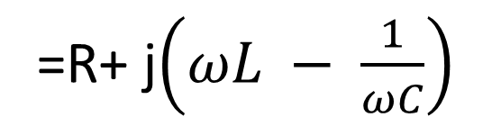
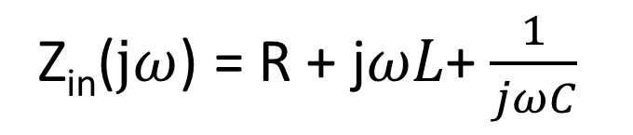

SALMAN
Series RLC Circuit
R
Ls
Z_{in}($jω$) = R + j$ωL$+ $\frac{1}{jωC}$
Z_{in}
$$\frac{1}{Cs}$$
=R+ j$\left(ωL − \frac{1}{ωC}\right)$
At resonance
Z_{in}
$ωrL − \frac{1}{ωrC}$ = 0 $\overset{⇒}{} ωr= \frac{1}{\sqrt{LC}}$
At Resonance, series LC acts as a short circuit and $Z_{in}\left(jw\right)=R$

Slide 6
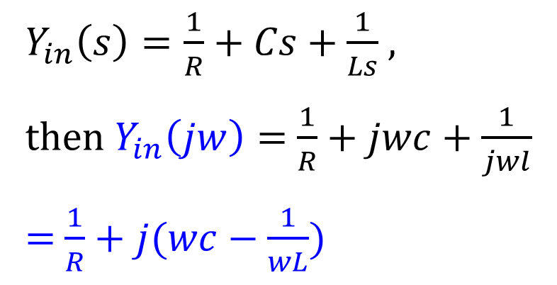

Parallel RLC Circuit
$Y_{in}\left(s\right)=\frac{1}{R}+Cs+\frac{1}{Ls}$ ,
then $Y_{in}\left(jw\right)=$ $\frac{1}{R}+jwc+\frac{1}{jwl}$
= $\frac{1}{R}+j(wc−\frac{1}{wL})$
Y_{in}
$$\frac{1}{Cs}$$
R
Ls
At resonance
Y_{in}

Slide 7

SALMAN
Parallel RLC Circuit
$Y_{in}\left(s\right)=\frac{1}{R}+Cs+\frac{1}{Ls}$ ,
then $Y_{in}\left(jw\right)=$ $\frac{1}{R}+jwc+\frac{1}{jwl}$
= $\frac{1}{R}+j(wc−\frac{1}{wL})$
Y_{in}
$$\frac{1}{Cs}$$
R
Ls
At resonance
Y_{in}
$ωrL − \frac{1}{ωrC}$ = 0 $\overset{⇒}{} ωr= \frac{1}{\sqrt{LC}}$

Slide 8
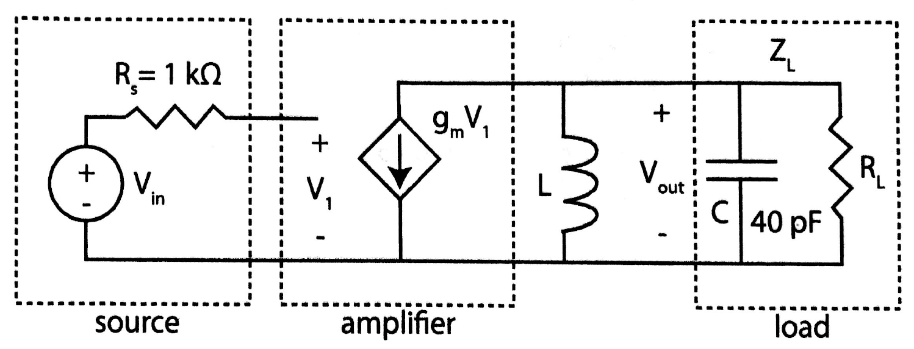
Example -1
For the circuit shown, which represents the equivalent circuit of an amplifier circuit, given that RL=20KΩ, gm=2ms, the magnitude of Vin is 0.1 V with f=10MHz. calculate the following:
1- The magnitude of the output voltage across RL.
2- Calculate the gain (Vout / Vin).
3- In order to maximize the gain, an inductor will be connected to resonate with the capacitor at the load side. Calculate the value of “L”, which is required to resonate with “c”.
4- Calculate the output voltage after connecting the inductor “L”.
5-Calculate the new gain.

Slide 9





1- The magnitude of the output voltage across RL.
$$Z_{L}\left(jw\right)=397.8$$
$$−88.9^{o}$$
$$Ω$$
$$V_{out}$$
$$=0.1∗0.002∗397.8=0.0796 V$$
2- Calculate the gain (Vout / Vin).
$$Gain=(\frac{0.0796}{0.1})=0.796$$

Slide 10
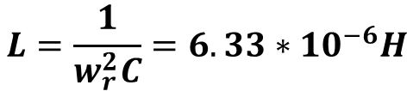


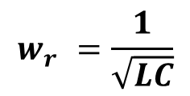
At resonance
3- Calculate the value of “L”, which is required to resonate with “c”.
$$w_{r}^{}=\frac{1}{\sqrt{LC}}$$
$$L=\frac{1}{w_{r}^{2}C}=6.33∗{10}^{−6}H$$
4- Calculate the output voltage after connecting the inductor “L”.
$$V_{out}$$
$$=0.1∗0.002∗20000=4 V$$
5-Calculate the new gain.
$$Gain=(\frac{4}{0.1})=40$$

Slide 11


Example -2
For the coupling circuit shown in the figure, find the following:
Y_{in}( jω ) , ω_{r} and Y_{in}( jω_{r} ) .
R
L
Y_{in}
$$C$$
At Resonance.
$$Yin( jωr )$$

Slide 12
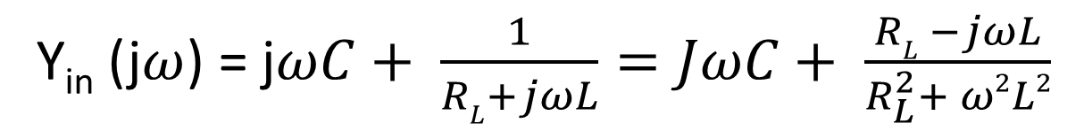
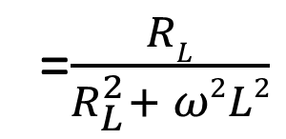
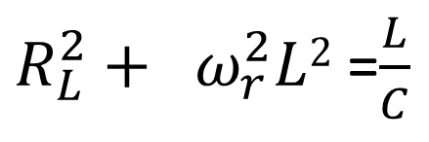
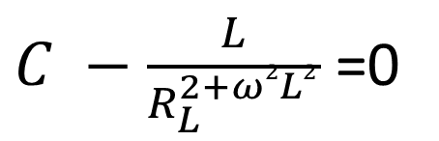
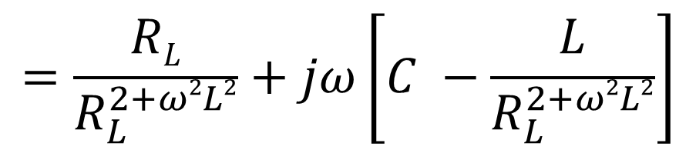
salman
Example -2
For the coupling circuit shown in the figure, find the following:
Y_{in}( jω ) , ω_{r} and Y_{in}( jω_{r} ) .
Y_{in} (j$ω$) = j$ωC+ \frac{1}{RL+jωL}=JωC+ \frac{RL −jωL}{R_{L}^{2}+ ω2L2}$
R
L
$$=\frac{RL}{R_{L}^{2+ω2L2}}+jω\left[C −\frac{L}{R_{L}^{2+ω2L2}}\right]$$
Y_{in}
$$C$$
At Resonance.
$C −\frac{L}{R_{L}^{2+ω2L2}}$ =0
$R_{L}^{2}+ ω_{r}^{2}L2$ =$\frac{L}{C}$
=$\frac{RL}{R_{L}^{2}+ ω2L2}$
$$Yin( jωr )$$

Slide 13


At resonance
R
L
Y_{in}
Y_{in}
$$Yin( jωr )$$
$$C$$

Slide 14
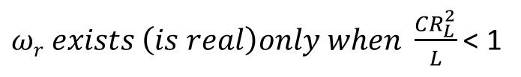
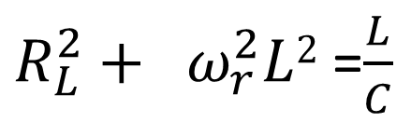
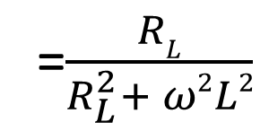
SALMAN
$R_{L}^{2}+ ω_{r}^{2}L2$ =$\frac{L}{C}$
$ω_{r}^{2}= \frac{1}{CL} − \frac{R_{L}^{2}}{L2} \overset{⇒}{} ωr= \sqrt{\frac{1}{CL} − \frac{R_{L}^{2}}{L2}}=\frac{1}{\sqrt{LC}}$ $\sqrt{1−\frac{CR_{L}^{2}}{L}}$
$ωr exists \left(is real\right)only when \frac{CR_{L}^{2}}{L}$ < 1
At resonance
R
L
Y_{in}
=$\frac{RL}{R_{L}^{2}+ ω2L2}$
Y_{in}
$$Yin( jωr )$$
$$C$$

Slide 15


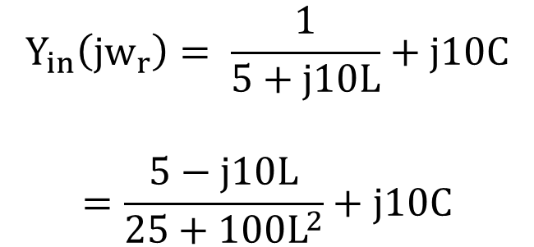

Example -3
Design a coupling (matching) network to achieve maximum power transfer from the source to the load R_{L} = 5 Ω. The source is v_{in} = 12 V_{rms} at 10 rad/s.
R_{S} = 10 Ω
$$L$$
To achieve the maximum power Zin has to equal to Rs or Yin has to equal to (1/Rs) at resonance.
Y_{in}
$$C$$
Y_{in} (jw_{r}) = 1/R_{s}
12 V at
10 rad/sec
+
R_{L}
-
$$Y_{in}\left(jw_{r}\right)= \frac{1}{5+j10L}+j10C$$
$$=\frac{5−j10L}{25+100L^{2}}+j10C$$
R_{S} = 10 Ω
Y_{in}
Y_{in} = 1/R_{S}
= 0.1 s
12 V at
10 rad/sec
+
-
This has to equal to
$$=0.1+j0$$

Slide 16
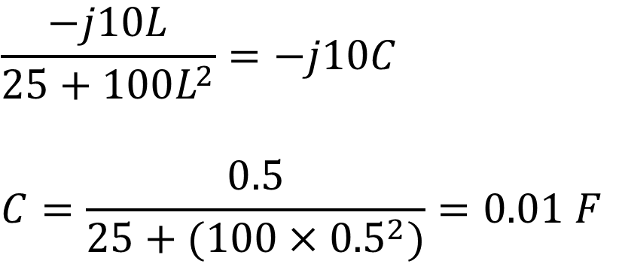
$$\frac{−j10L}{25+100L^{2}}=−j10C$$
$$C=\frac{0.5}{25+(100×{0.5}^{2})}=0.01 F$$

Slide 17

Example -4
L
For the coupling circuit shown in the figure, find the following:
Z_{in}( jω ) , ω_{r} and Z_{in}( jω_{r} ) .
Z_{in}
G_{L}=$\frac{1}{RL}$
C

Slide 18
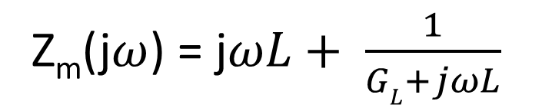
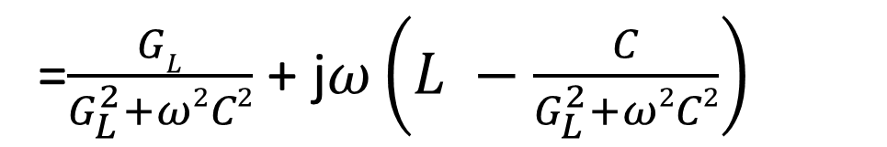
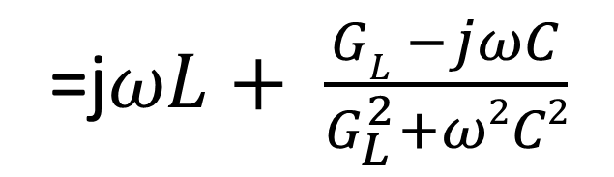
Example -4
SALMAN
L
For the coupling circuit shown in the figure, find the following:
Z_{in}( jω ) , ω_{r} and Z_{in}( jω_{r} ) .
Z_{in}
G_{L}=$\frac{1}{RL}$
C
Z_{m}(j$ω$) = j$ωL+ \frac{1}{GL+jωL}$
=j$ωL+ \frac{GL −jωC}{G_{L}^{2}+ω2C2}$
=$\frac{GL}{G_{L}^{2}+ω2C2}$ + j$ω\left(L −\frac{C}{G_{L}^{2}+ω2C2}\right)$

Slide 19

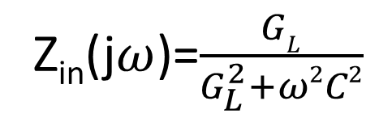

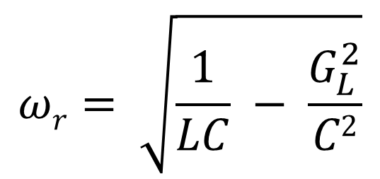
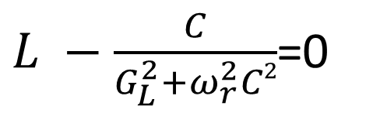
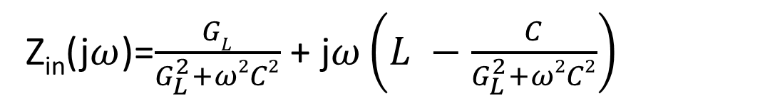
Z_{in}(j$ω$)=$\frac{GL}{G_{L}^{2}+ω2C2}$ + j$ω\left(L −\frac{C}{G_{L}^{2}+ω2C2}\right)$
$$ωr= \sqrt{\frac{1}{LC} − \frac{G_{L}^{2}}{C2}}$$
$L −\frac{C}{G_{L}^{2}+ω_{r}^{2}C2}$=0
then
Z_{in}(j$ω$)=$\frac{GL}{G_{L}^{2}+ω2C2}$
At resonance
L
Z_{in}
Z_{in}
C
$$Zin(jωr)$$
G_{L}=$\frac{1}{RL}$

Slide 20
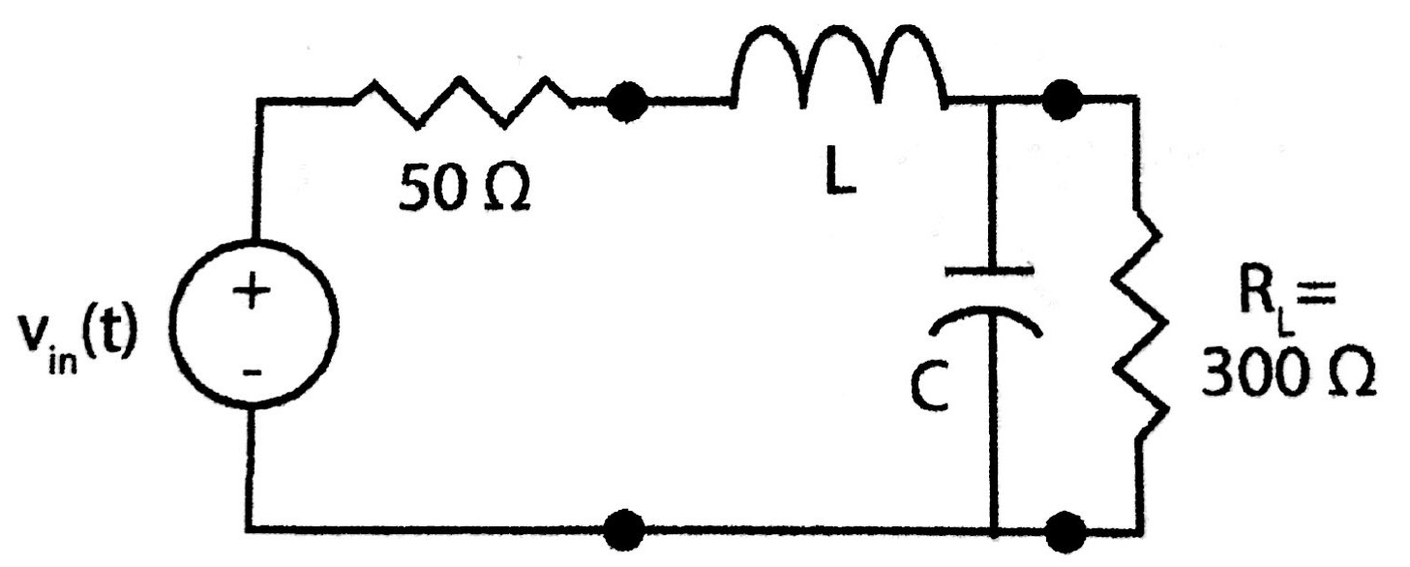
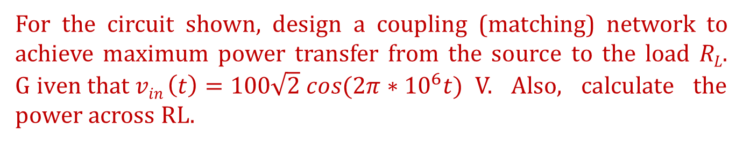


Example -5
For the circuit shown, design a coupling (matching) network to achieve maximum power transfer from the source to the load R_{L}. G$iven that vin \left(t\right)=100\sqrt{2} cos(2π∗{10}^{6}t)$V. Also, calculate the power across RL.
To achieve the maximum power Zin has to equal to Rs or Yin has to equal to (1/Rs) at resonance.
$$L=17.9 μH$$
$$C=1186pF$$

Slide 21
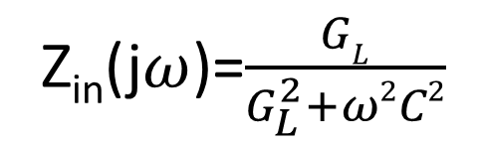
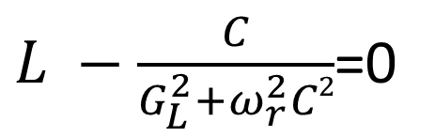
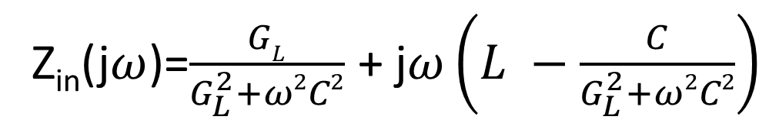
Example -5
salman
For the circuit shown, design a coupling (matching) network to achieve maximum power transfer from the source to the load R_{L}. G$iven that vin \left(t\right)=100\sqrt{2} cos(2π∗{10}^{6}t)$V. Also, calculate the power across RL.
To achieve the maximum power Zin has to equal to Rs or Yin has to equal to (1/Rs) at resonance.
Z_{in}(j$ω$)=$\frac{GL}{G_{L}^{2}+ω2C2}$ + j$ω\left(L −\frac{C}{G_{L}^{2}+ω2C2}\right)$
$L −\frac{C}{G_{L}^{2}+ω_{r}^{2}C2}$=0
$$L=17.9 μH$$
Z_{in}(j$ω$)=$\frac{GL}{G_{L}^{2}+ω2C2}$
$$C=1186pF$$

Slide 22
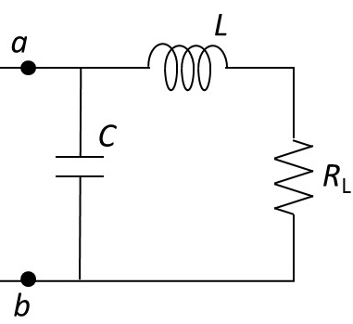
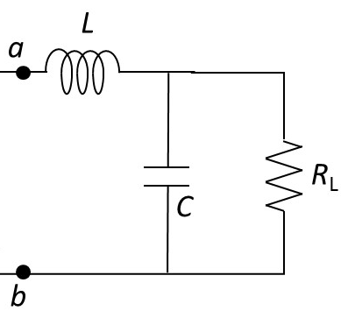
R_{L}< R_{s}
R_{L}> R_{s}

Slide 23
Answer the following questions using ChatGPT
Explain the condition for resonance in a series RLC circuit and a parallel RLC circuit. Why is the input impedance purely real at the resonant frequency?
In a matching network, explain the significance of matching the input impedance Zin​ to the source impedance Rs​ at the resonant frequency.
How does this impact power transfer efficiency?
Provide two practical scenarios where resonance is used to enhance circuit performance, and explain the role of resonance in each case.

Slide 24
Summary
Resonance occurs when the inductive reactance (XLX_LXL​) and capacitive reactance (XCX_CXC​) in a circuit are equal in magnitude but opposite in phase.
Series RLC Circuit - Minimum impedance and maximum current.
Parallel RLC Circuit - Maximum impedance and minimum current.
Energy oscillates between the inductor's magnetic field and the capacitor's electric field at the resonant frequency.
Resonance is a vital principle in circuit design, enabling precise control over frequency, energy transfer, and amplification.

